Slide 1
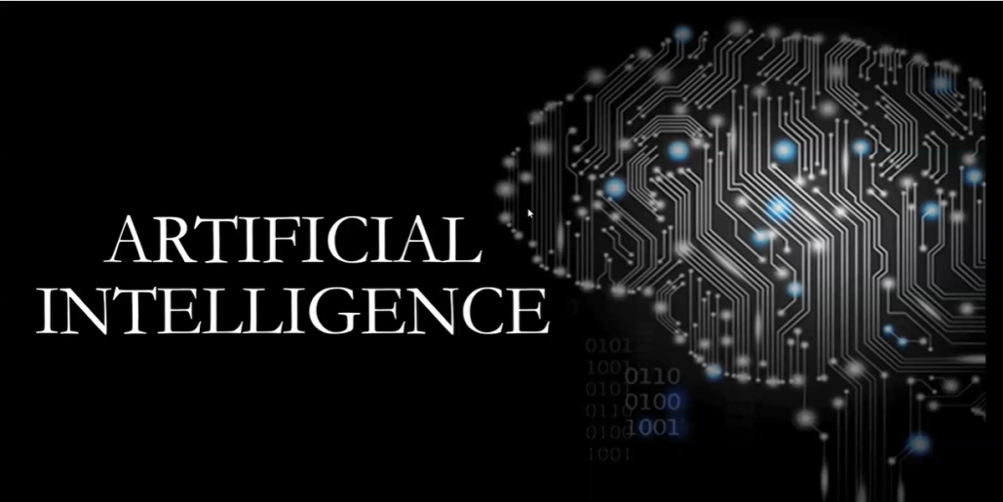

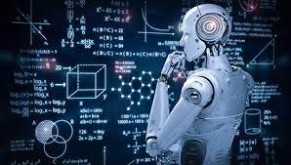

PROJECT PRESENTATION
UJJWAL CHICHKHEDE

Slide 2
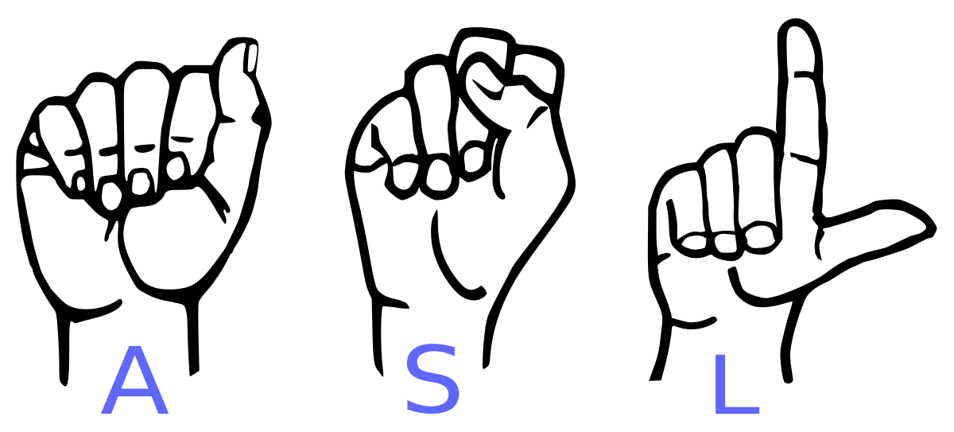
HAND SIGN DETECTION USING CNN
PROJECT TITLE & OBJECTIVE
OBJECTIVE : To build a model which can identify the
Hand symbols & classifying them.

Slide 3
WORKING OF PROJECT:
1. Import the libraries
2.Reshaping and Normalizing the Images (preprocessing )
3. Building the Convolutional Neural Network
4. training the model
5. sign recognised

Slide 4

IMPORT THE LIBRARYS:
Tensorflow :
TensorFlow is an open source machine learning platform
developed by Google. It has a JavaScript library for
deploying machine learning models in the browser, a lite
version for mobile and IoT devices, and an extended e
version for large production environments

Slide 5


2) Keras:
Keras is a powerful and easy-to-use free open source Python library for developing and evaluating deep learning models. It wraps the efficient numerical computation libraries Theano and TensorFlow and allows you to define and train neural network models in just a few lines of code.
3) Cv zone:
Computer vision is a process by which we can understand the images and videos how they are stored and how we can manipulate and retrieve data from them.

Slide 6
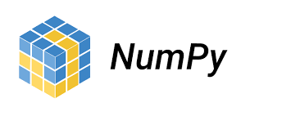
4) Numpy:
NumPy is a library for the Python programming language, adding support for large, multi-dimensional arrays and matrices, along with a large collection of high-level mathematical functions to operate on these arrays.
5) Media pipe:
Media pipe comes with some pre define ml solutions such as face recognition pose estimation, hand recognition, object detection etc

Slide 7
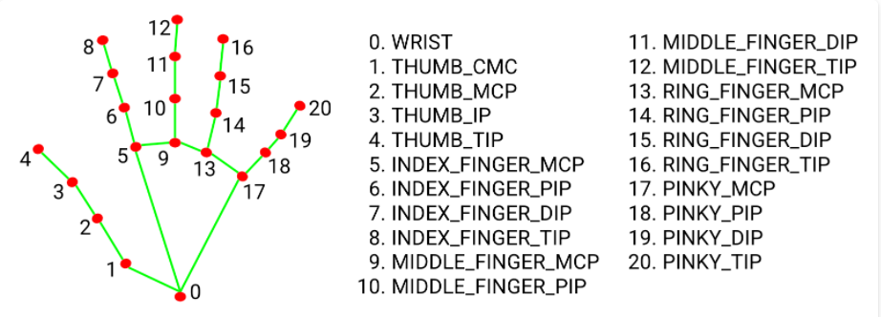
.
Media pipe to recognise the hand and the key points media pipe returns a total 21 key points for each hand detection

Slide 8
LOADING THE TRAINING DATA SET:
* Tensorflow and Keras allow us to import and download the trained dataset. * 5,000 testing images approx

Slide 9
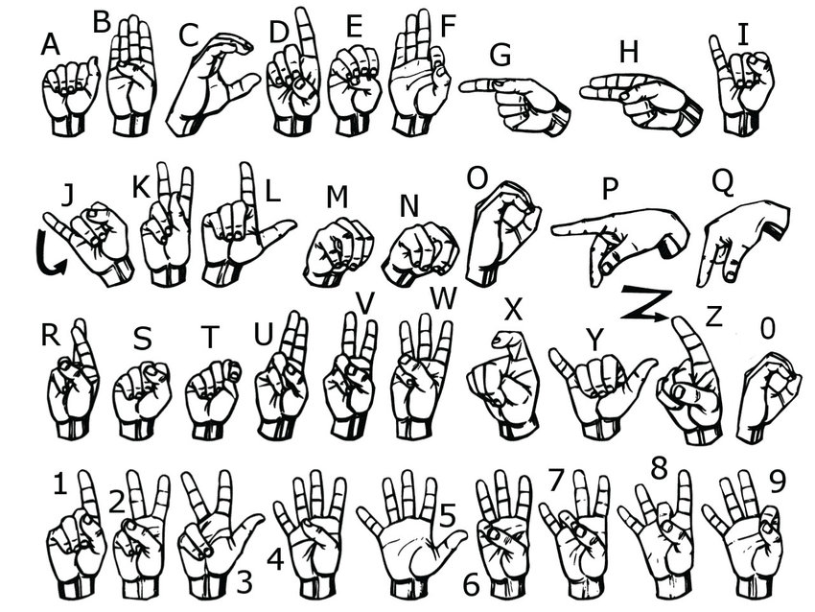

Slide 10
- Reshaping the array to 4-dims so that it can work with the Keras API(greyscale image) - Need to normalize our data as it is always required in neural network models, by dividing the RGB codes to 255 - So initially will be converting data to float as we are dividing.
PREPROCESED DATASET:

Slide 11
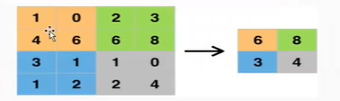
1) Sequential model allows you to build a model layer by layer. model,add(Conv20(28, kernel_size=(3,3), input_shape=input_shape)) #28 number of layers 2) Max pooling is a pooling operation that selects the maximum element from the region of the feature map covered by the filter. Thus, the output after max-pooling layer would be a feature map contains most prominent features of the previous feature map
BULDING THE CONVOLUTION NEURAL NETWORK:

Slide 12

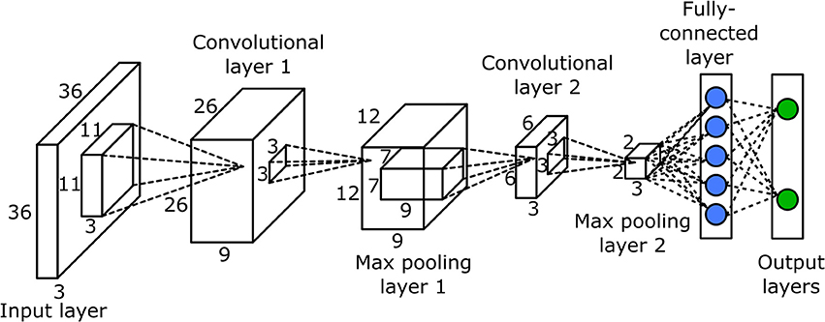

Slide 13
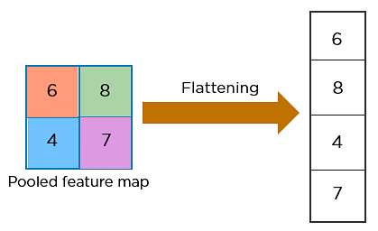
Flattening: involves transforming the entire pooled feature map matrix into a single column which is then fed to the neural network for processing.

Slide 14
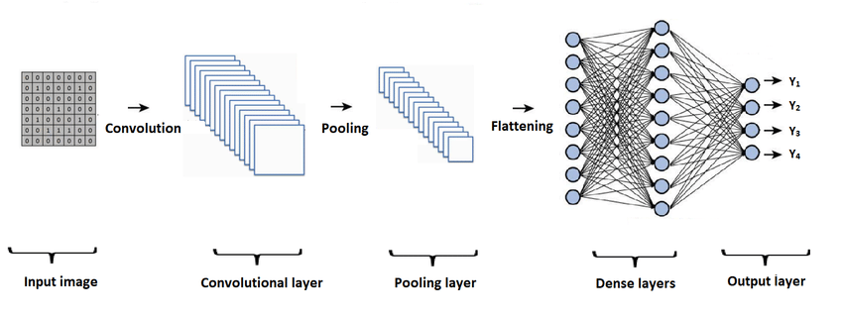
DENSE LAYER : A linear operation in which every input is connected to every output by a weight . It connects neurons in one layer to neurons in another layer. It is used to classify images between different category by training.

Slide 15
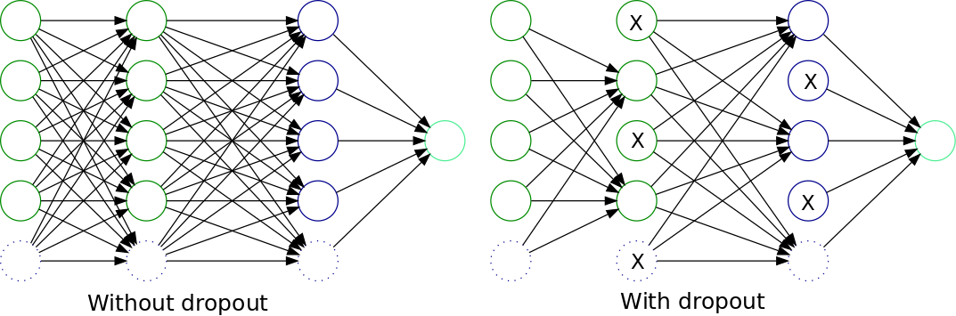
DROPOUT : A Simple Way to Prevent Neural Networks from Overfitting.

Slide 16
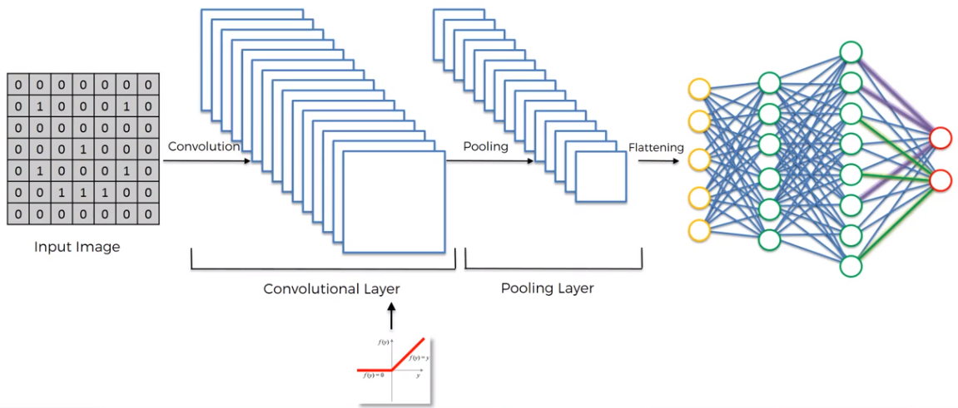
SOFTMAX LAYER: is the last layer of CNN. It resides at the end of FC layer, softmax is for multi-classification.

Slide 17
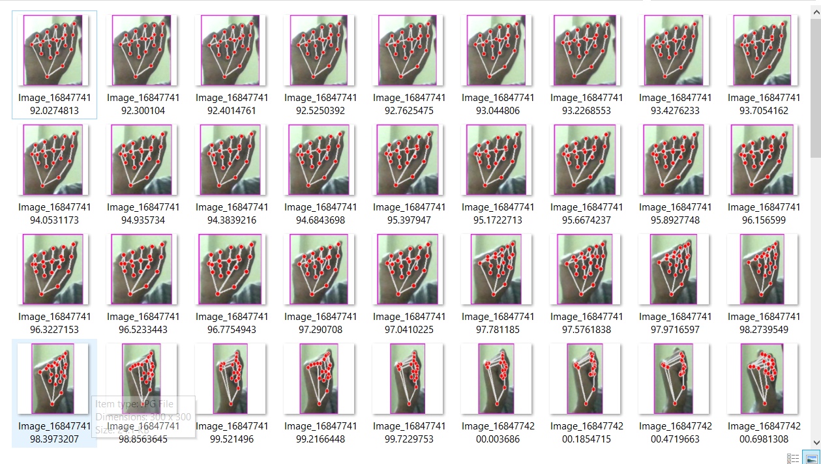
4) COMPILING AND TRAINING THE MODEL:

Slide 18
5. Hands sign recognised:
The model will be sucessful to recognise the hand sign.

Slide 19
OUTPUT OF MODEL

Slide 20
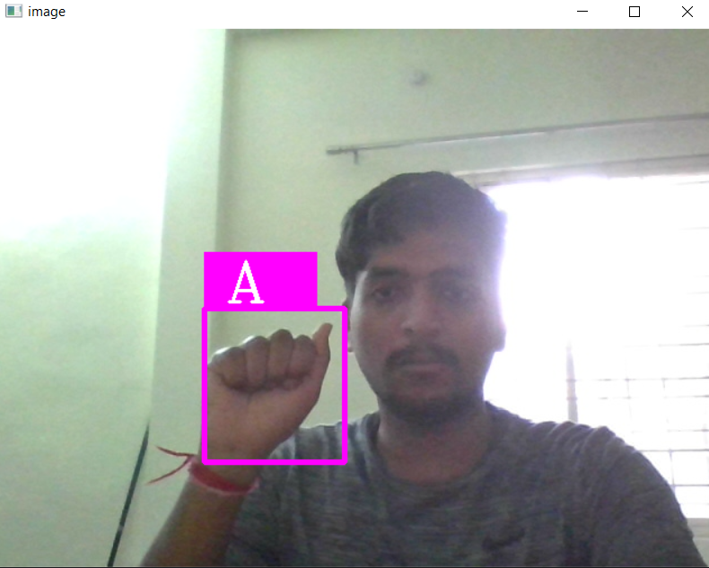
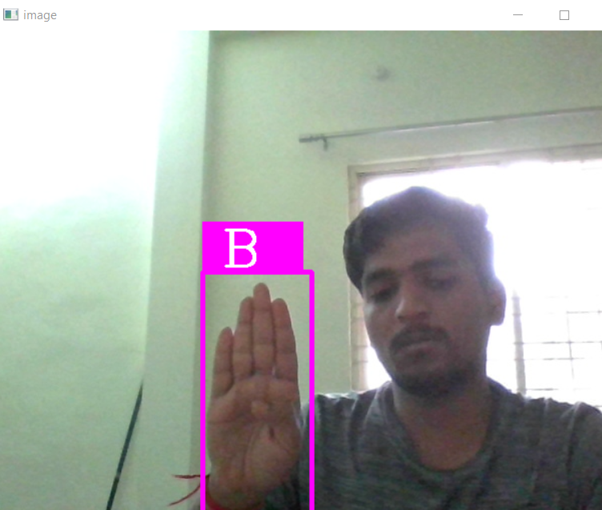
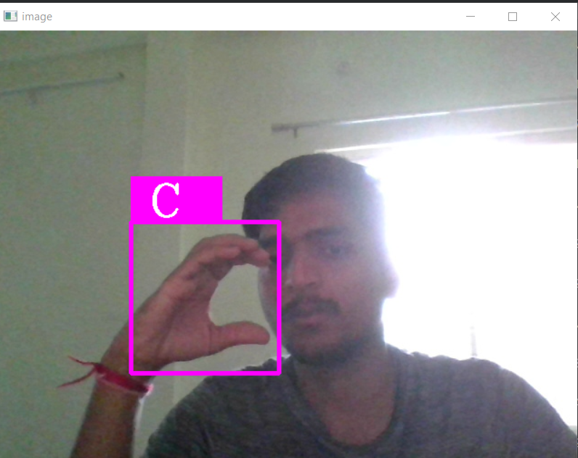
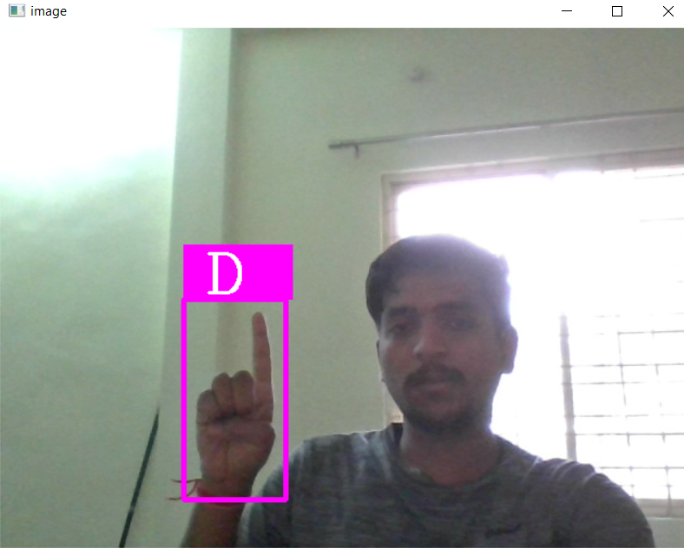
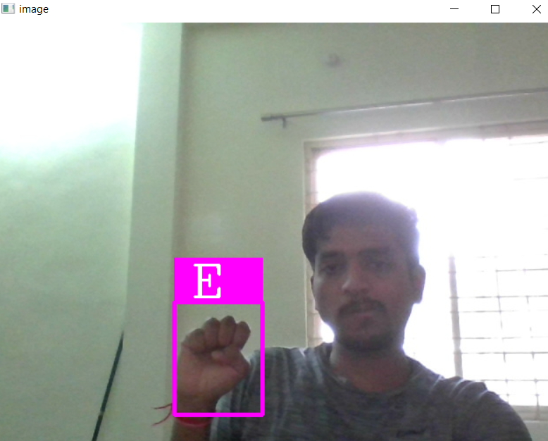
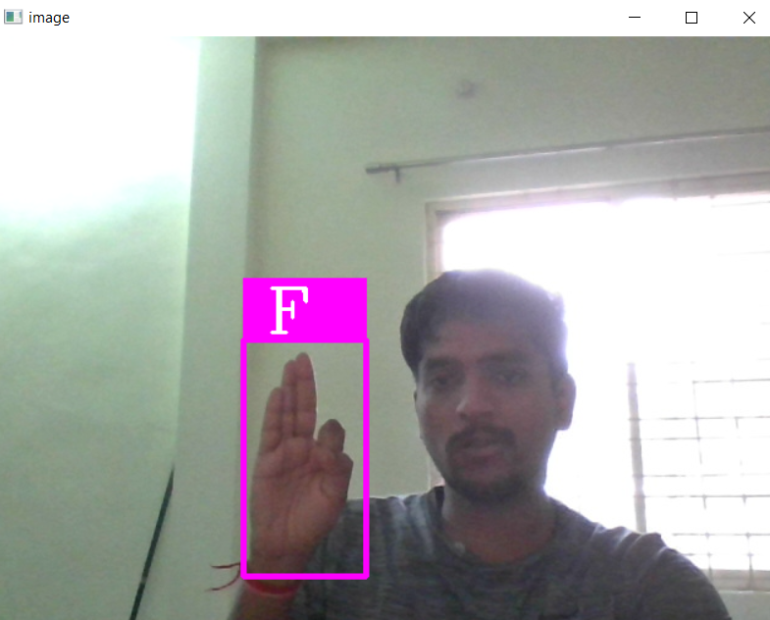

Slide 21
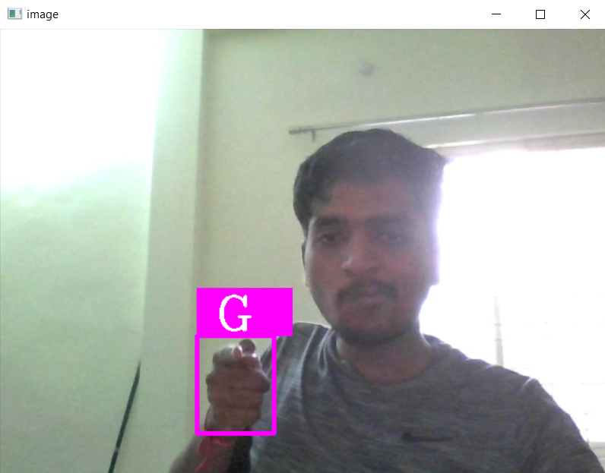
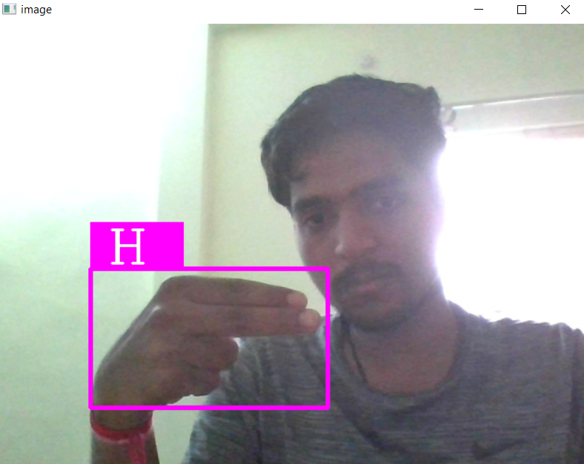
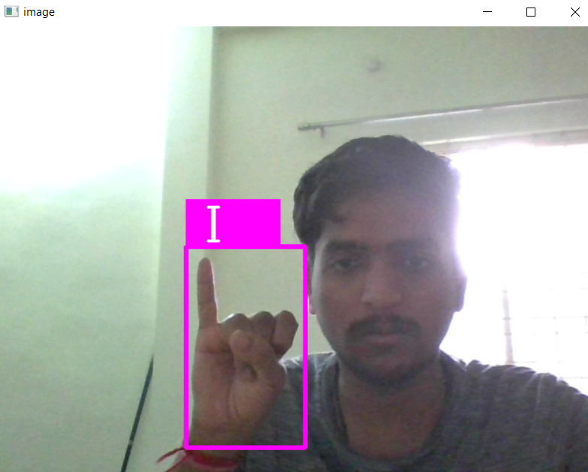
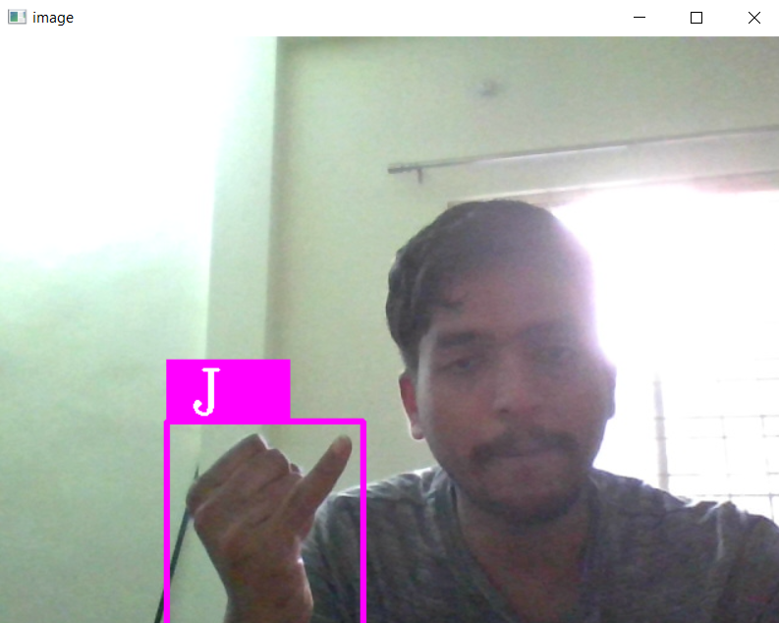
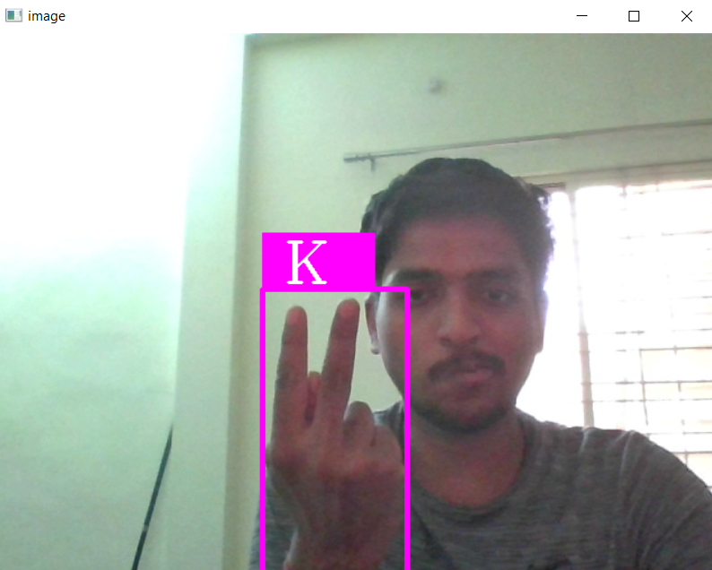
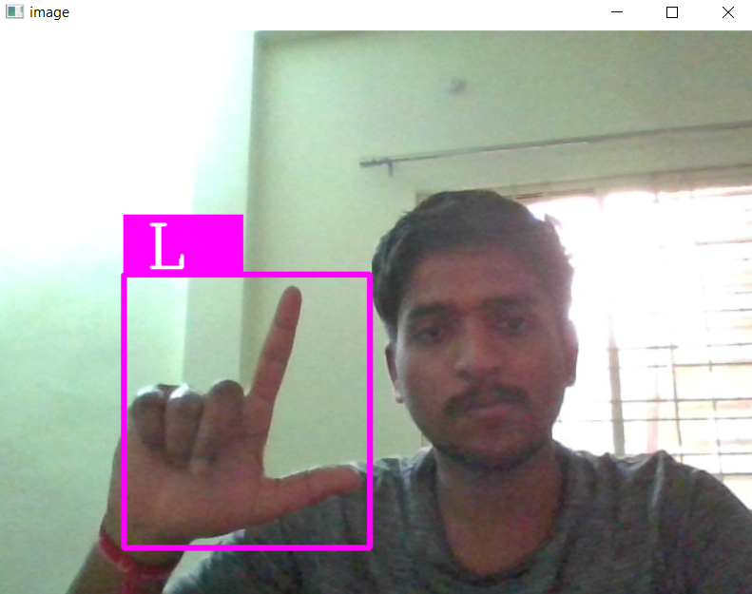

Slide 22
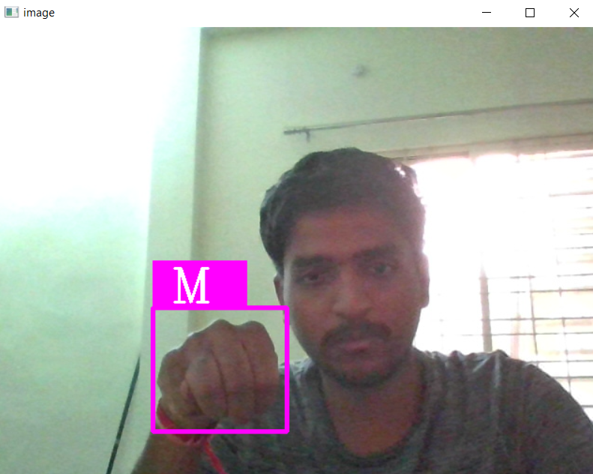
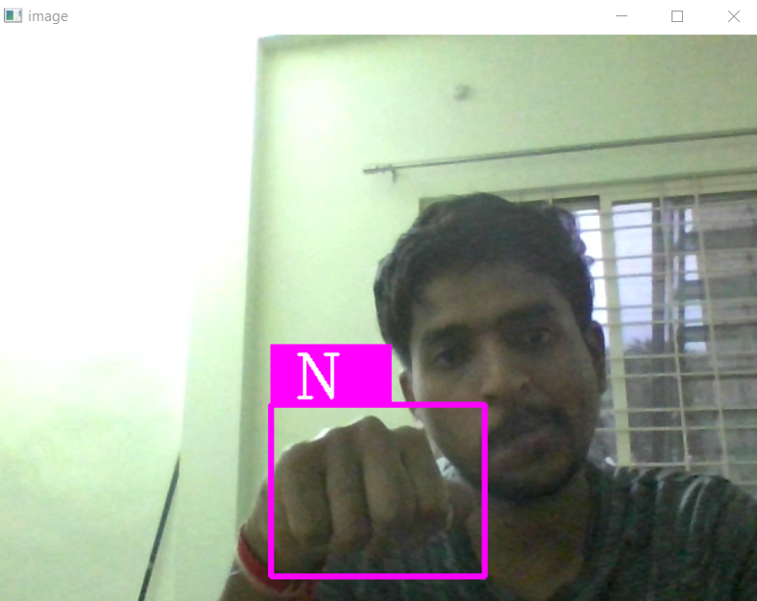
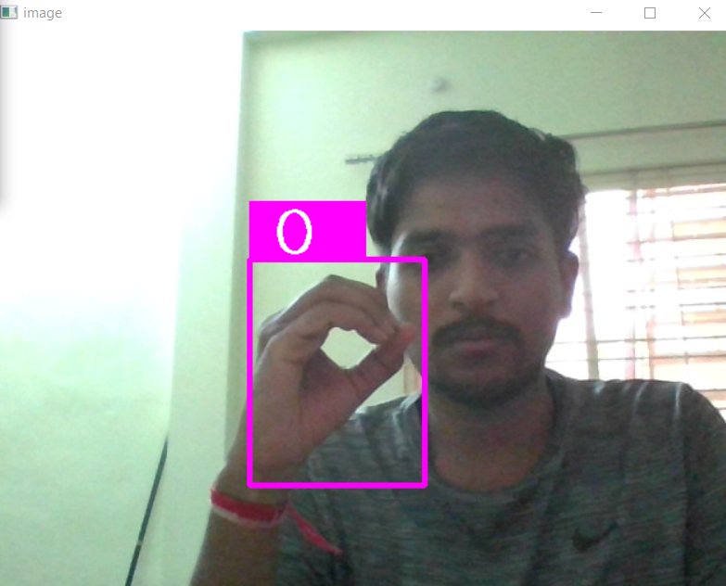
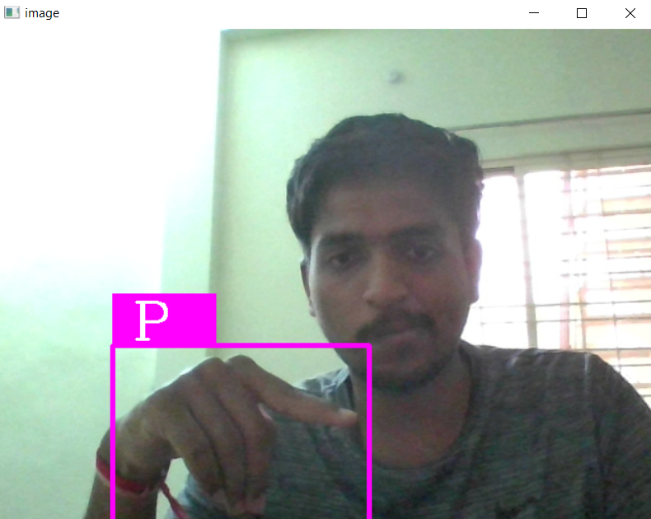
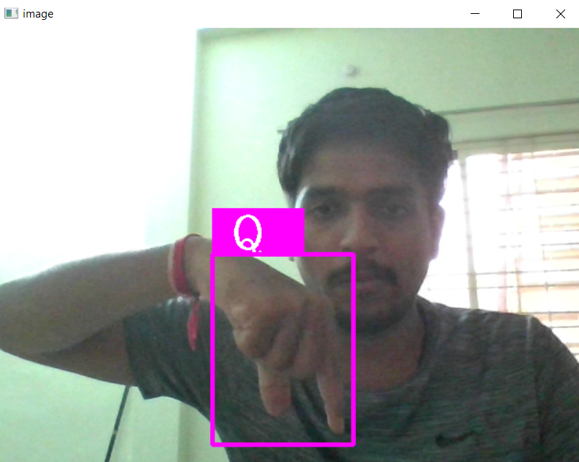
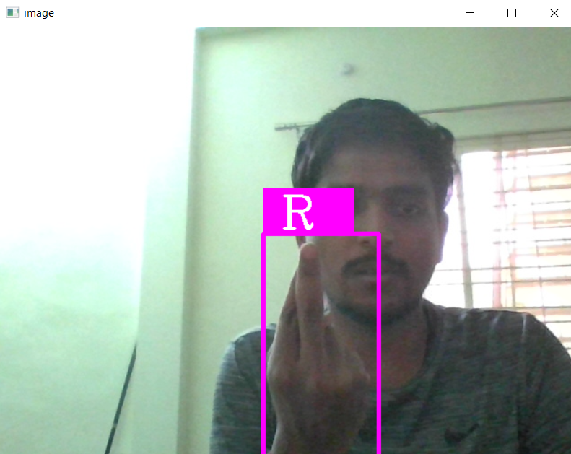

Slide 23
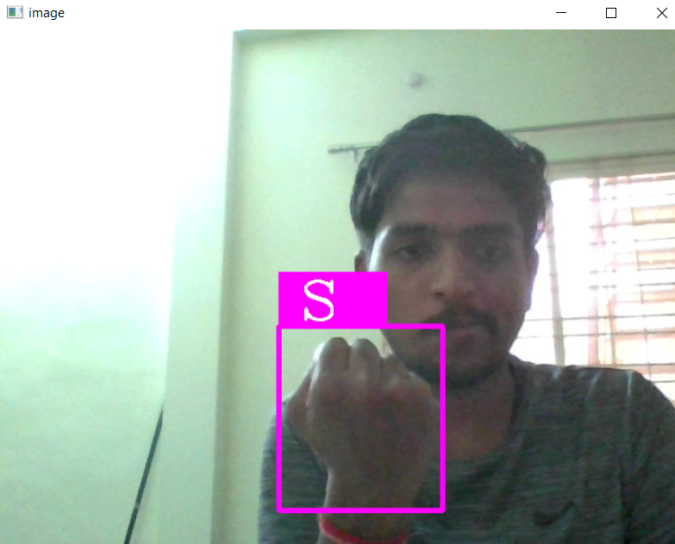
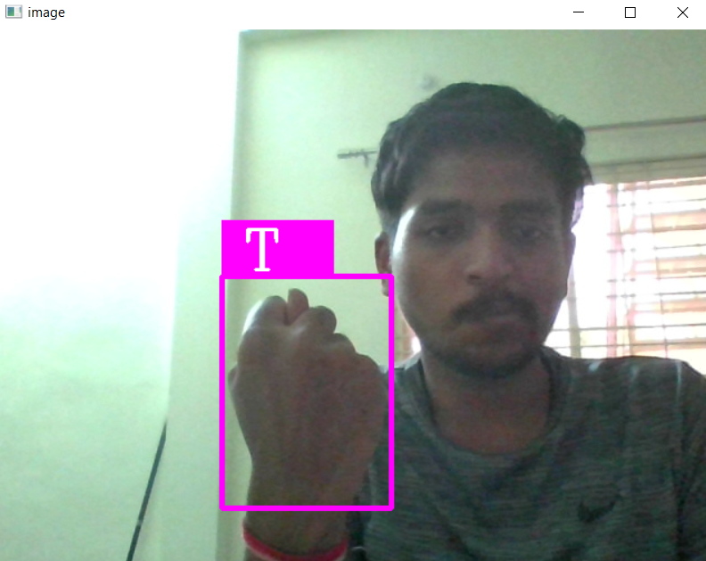
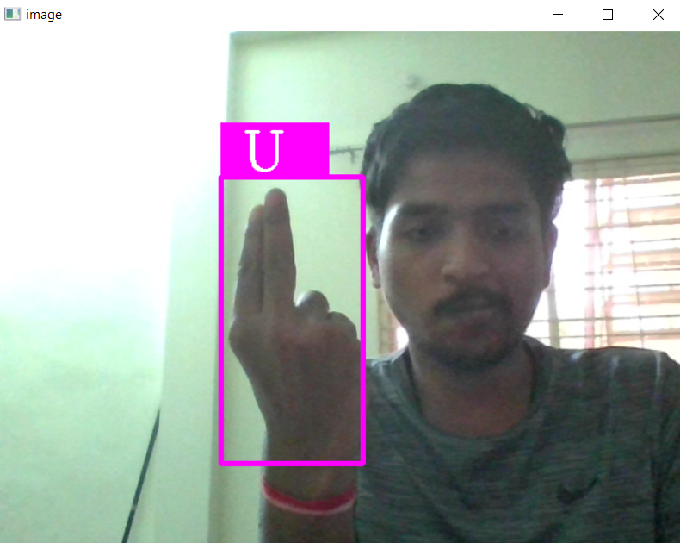
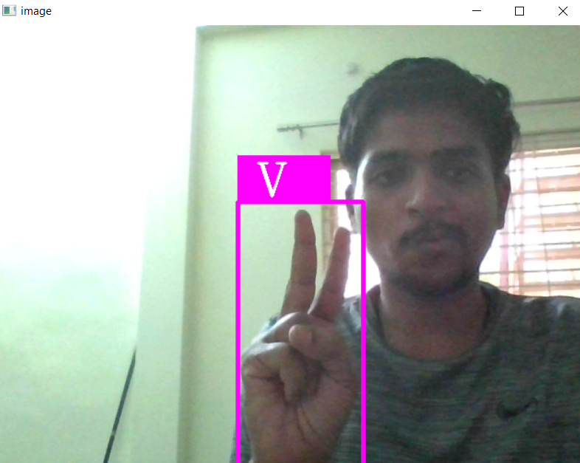
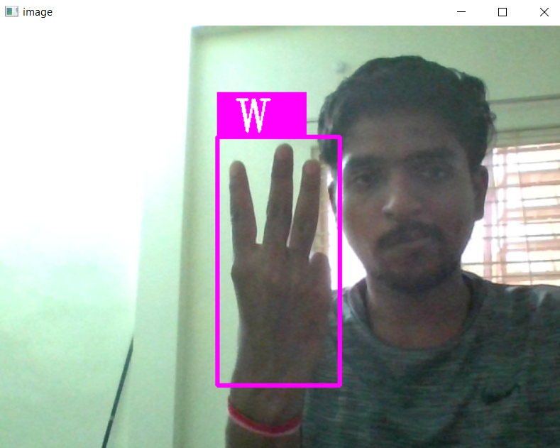
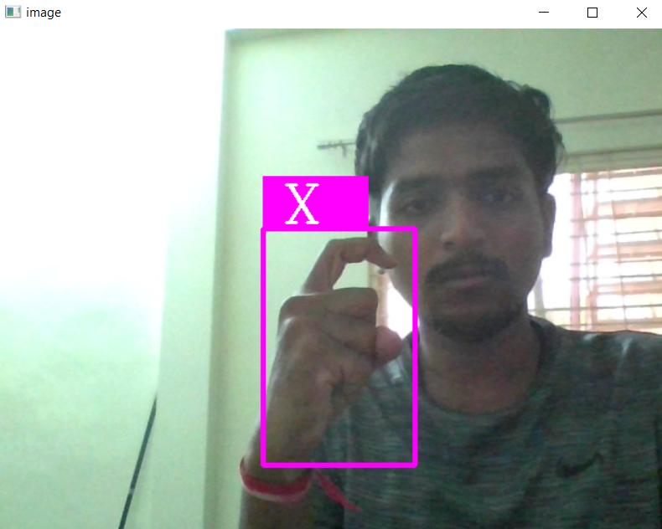

Slide 24
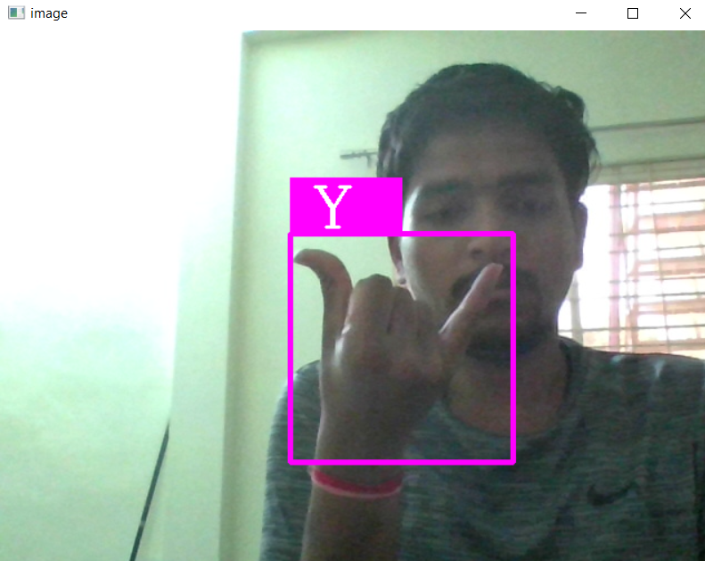
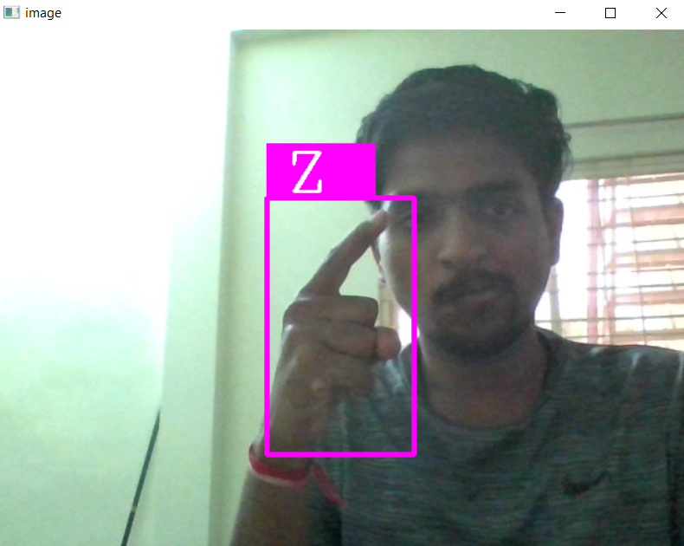

Slide 25
Technology used:
Hardware Requirements :
Processor : Intel(R) Core(TM) i5
RAM : 8.00 GB
System Type : 64-bit operating system
Software Requirements :
Operating System : Windows 10
Languages : Python
Technology : Machine Learning , Artificial Intelligence
Tools: py charm

